Slide 2
R3 ยุพาพร เพ็ชรคงทอง / อ. ธีรวัฒน์ ภูจิญญาณ์

Slide 3
Background
Interscalene block is associated with diaphragmatic paresis from phrenic nerve block
Attempts to mitigate the pulmonary dysfunction associated with brachial plexus block

Slide 4
Background
Performing blocks more distally along the brachial plexus.
Siegenthaler et al. have described a proximal selective anterior suprascapular nerve block within the supraclavicular fossa.
Performing a selective block of the anterior suprascapular nerve may minimize phrenic nerve paresis without compromising analgesia.

Slide 5
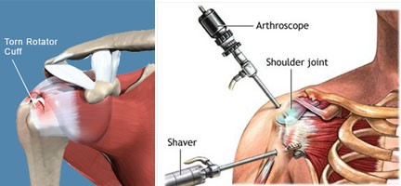
Background
The aim of this study was to compare the analgesic efficacy of three different brachial plexus nerve block approaches after rotator cuff or Bankart repair of the shoulder.
supraclavicular block or anterior suprascapular block would provide noninferior analgesia when compared to the interscalene while producing less pulmonary dysfunction.

Slide 6
Background
Primary outcome
11-point numerical rating scale pain scores 60 min after surgery completion.
Secondary outcomes (evaluated for superiority)
opioid consumption
vital capacity measurements
diaphragm excursion
motor and sensory changes of the ipsilateral upper extremity
block- and opioid-related side effects
patient satisfaction.

Slide 7
Materials and Methods
The Institutional Research Ethics Board (Benaroya Research Institute, Virginia Mason Medical Center, Seattle, Washington) approved this study.
Conducted between November 2014 and November 2016.
The study was prospectively registered at clinicaltrials.gov

Slide 8
Materials and Methods
Total of 189 subjects—63 per group—were planned for enrollment in this study.
Allocated in a 1:1:1 ratio with a computer generated simple randomization.
Interscalene
Supraclavicular
Suprascapular

Slide 9
Materials and Methods
The follow-up investigators, anesthesia personnel, surgeons, recovery nurses, and the study participants were all blinded to the randomization.
All data collection after discharge to home was collected via telephone by a blinded investigator.

Slide 10
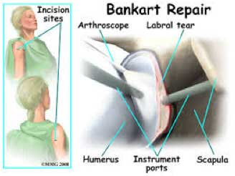
Inclusion criteria
Age greater than 18 yr
With American Society of Anesthesiologists physical status I to III
Undergoing unilateral shoulder surgery for rotator cuff or Bankart repair.

Slide 11
Exclusion criteria
Contraindications to nerve block or local anesthetics
Coagulopathy
Chronic opioid use

Slide 12
Preprocedure Recordings and Measurements
Demographic and baseline data were recorded before any interventions.
Pain at rest in the operative shoulder was assessed verbally, recorded on an 11-point numerical rating scale.
Baseline sensation to ice was evaluated over the C4 - C8 dermatomes. Biceps contraction and grip strength were assessed.

Slide 13
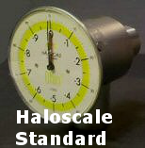
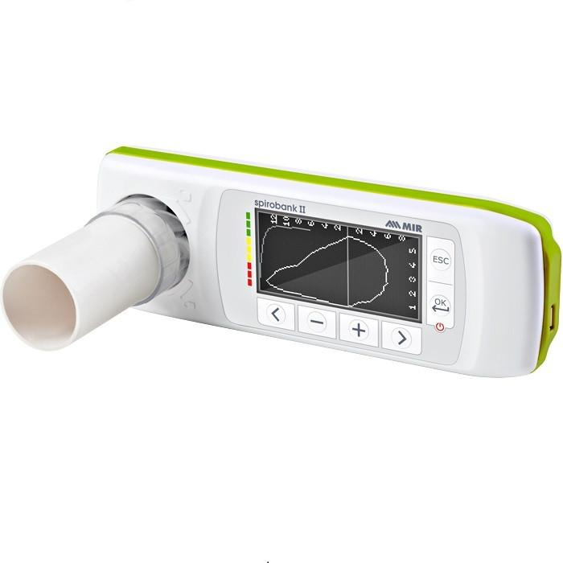
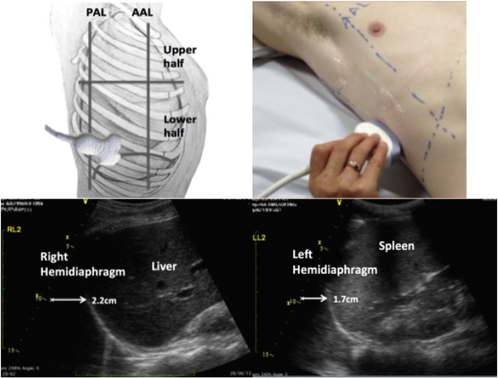
Baseline Pulmonary Assessment
Oxygen saturation using pulse oximetry was recorded on room air.
Vital capacity was measured using a Haloscale Standard Respirometer.
FEV1 measured with a MicroPlus Spirometer.
Diaphragmatic excursion in centimeters was measured by ultrasound in the mid-axillary line.

Slide 14
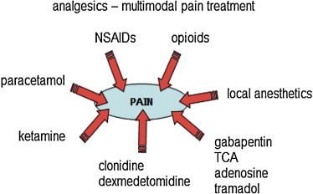
Multimodal Analgesia
As is standard of care for outpatient orthopedic procedures, all subjects received
975 mg oral acetaminophen
and 200 mg oral celecoxib in the preoperative holding area, unless contraindicated.

Slide 15
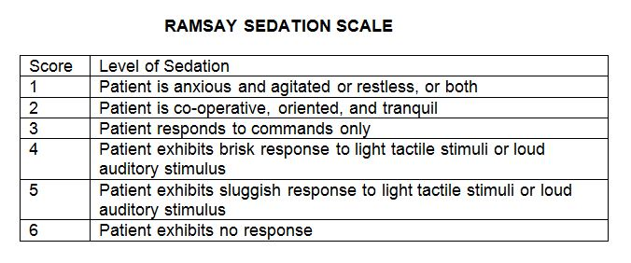
Nerve Block Procedure
Randomization assignments were kept in sealed envelopes, and then opened by the research anesthesiologist immediately prior to the nerve block.
Standard ASA monitors and supplemental oxygen.
Sedated with IV propofol (0 to 0.5 mg/kg) and/or IV midazolam (0 to 20 mcg/kg).

Slide 16
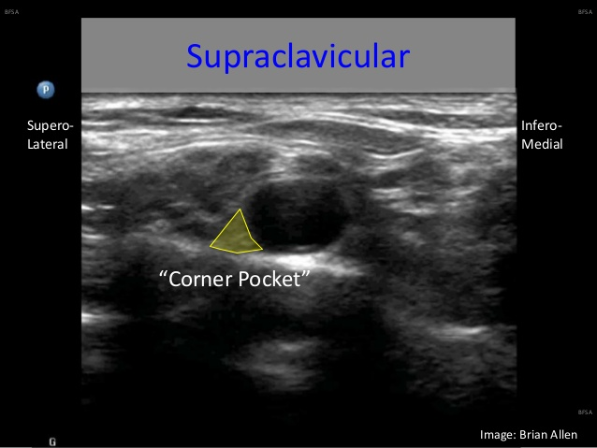
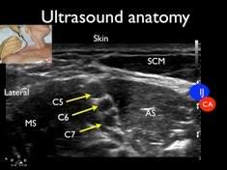
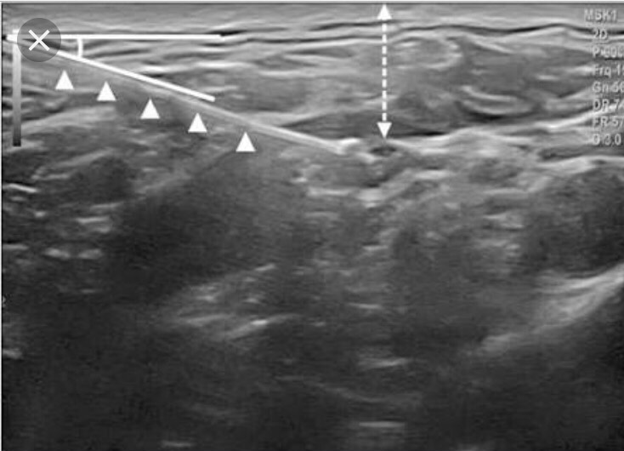
Nerve Block Procedure
interscalene nerve block group
supraclavicular block group
anterior suprascapular nerve block group

Slide 17
Nerve Block Procedure
15 ml, 0.5% ropivacaine was injected at the desired location.
19-gauge wire-reinforced catheter was placed through the Tuohy needle and secured.
No local anesthetic was infused through the perineural catheters until all data were collected in the postanesthesia care unit (PACU).

Slide 18
Intraoperative Management
GA was induced with propofol (1 to 2 mg/kg) for the placement of LMA and maintained at less than or equal to 1 MAC with sevoflurane.
Standardized opioid algorithm was used intraoperatively, with IV fentanyl, 25 mcg given for the following criteria
increase in heart rate of 10 beats per minute
or increase in baseline systolic blood pressure of 20 mmHg due to surgical stimulus

Slide 19
PACU Management
PACU Recordings and Measurements
performed by a blinded researcher, 60 min after the completion of surgery.
discharge when reaching a score greater than or equal to 10 on the 14-point modified Aldrete’s scoring system per the blinded PACU nurse.

Slide 20
Postoperative Pain and Opioid Consumption
Standard PACU opioid algorithm was used
NRS pain score 4 to 6, 25 mcg of IV fentanyl was delivered.
NRS pain score 7 to 10, 50 mcg of IV fentanyl was delivered.
Upon completion of assessment by the blinded investigators, both IV and oral opioids were available to the PACU nurse.
NRS pain score 4 to 6, oxycodone 5 mg was given.
NRS pain score 7 to 10, oxycodone 10 mg was given.

Slide 21
Postoperative Pulmonary and Nerve Block Assessment
All variables, including the primary outcome (pain), were assessed at 60 min after surgery.
PACU vital capacity, FEV1, SpO2, diaphragmatic excursion, and motor and sensory changes were all measured in the same as the preoperative assessments.

Slide 22
Adverse Effects
Adverse Effects
The incidence of opioid-induced adverse events was recorded along with potential brachial plexus block side effects.
24-h Follow-up
Telephone calls were placed on postoperative day 1, 24 h after surgery completion, by a blinded investigator.

Slide 23
Statistical Methods
The primary endpoint of this trial was pain in PACU, using one-way ANOVA, and the 95% CIs for the pairwise differences in pain
The noninferiority hypothesis was tested using a one-sided t test for independent group, P values less than 0.013 were considered significant for these one-sided tests.

Slide 24
Statistical Methods
Secondary endpoints were compared using the t test for independent groups.
Categorical variables were compared using the chi-square test or Fisher exact test.
P < 0.025 was the threshold for significance for two-sided tests.

Slide 28
Results
Primary Outcome: PACU Pain Score 60 Min after Surgery
mean current pain in PACU :
1.9 for interscalene nerve block (95% CI, 1.3 to 2.5)
2.3 for supraclavicular block (95% CI, 1.7 to 2.9)
2.0 for anterior suprascapular nerve block (95% CI, 1.4 to 2.6).

Slide 29
Pain and Opioid Consumption

Slide 30
PACU Pulmonary Function

Slide 31
PACU Block Assessment, Side Effects, and Satisfaction

Slide 32
24-h Assessment

Slide 33
Discussion
pain scores following major outpatient arthroscopic shoulder surgery in subjects receiving anterior suprascapular nerve blocks alone is noninferior when compared to an interscalene block.
Several outcomes evaluating pulmonary function did show superiority in the suprascapular group compared to the interscalene group.

Slide 34
Discussion
Symptomatic dyspnea did not vary between groups at PACU or 24-h assessments, however, subjects with preexisting lung dysfunction were excluded from this study.
If postoperative lung preservation is a significant priority, then an anterior suprascapular block should be the first to be considered.

Slide 35
Discussion
A recent study examining distal suprascapular nerve block reported high failure rates and significantly greater opioid consumption, when compared to an interscalene block.
Recent advances in anatomical understanding report that the posterior division of the upper trunk lies in close approximation to the suprascapular nerve

Slide 36
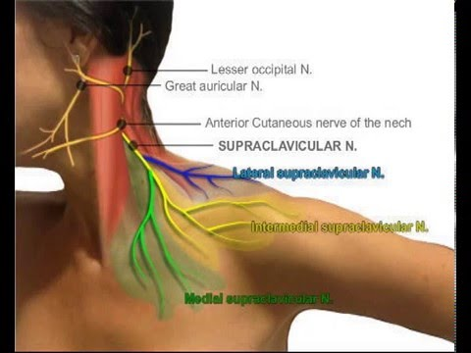
Discussion
Minimum effective anesthetic volumes studies generally suggest that the supraclavicular block requires a larger volume for block efficacy compared to interscalene nerve block.

Slide 37
limitations
First, outcomes after the PACU assessments (secondary outcomes) must take into account the use of a continuous infusion of 0.2% ropivacaine.
The use of a continuous infusion means we have no true pharmacodynamic data of block duration, nor assessment of analgesic efficacy after PACU discharge for a single injection block at these three brachial plexus locations.

Slide 38
limitations
Second, this ultrasound-guided anterior suprascapular approach in the supraclavicular fossa is a relatively novel technique, The results presented here should not be extrapolated to other suprascapular nerve block locations.
Third, the preoperative baseline pain scores were lowest in the suprascapular group, although not clinically significant.

Slide 39
conclusion
Analgesia provided by an anterior suprascapular nerve block following outpatient arthroscopic shoulder surgery is noninferior to an interscalene nerve block and best preserves pulmonary function.
this study also supports the clinical analgesic efficacy of the supraclavicular block, although statistical noninferiority to the interscalene nerve block was not supported by the data.

Slide 40
Critical Appraisal : RCT
Does this study address a clear question?

Slide 41
Critical Appraisal : RCT
Are the results of this single trial valid?

Slide 42
Critical Appraisal : RCT
Are the results of this single trial valid?

Slide 43
Critical Appraisal : RCT
What were the results?
NO
YES

